Slide 1

Property Management

Slide 2




About Us
Our Mission
Services Offered
Fees
History
Leadership
Our Process
Contact Us

Slide 3

Our Mission
Whether you are an aspiring investor, a seasoned investor, doing house hacking, or a home-owner converting your house into a rental... we strive to provide a no stress, no hassle, just property management done right
Notes:
Our mission is to provide seamless and stress-free property management services to our clients. We operate with complete transparency and strive to exceed your expectations. With our comprehensive services, we allow you to enjoy the benefits of property ownership without any hassle.

Slide 4
Services Offered
Market Analysis
Tenant Management
Maintenance Management
Rent Collection and Reporting
Piece of Mind
Personalized Add-Ons

Slide 5

Market Analysis
Analyzing market trends to determine optimal pricing strategy
Evaluating current rental rates to ensure maximum profitability
Keeping up-to-date on economic factors that may affect pricing decisions
Take professional pictures for marketing

Slide 6

Tenant Management
Application Processing
  Reviewing and screening tenant applications
  Conducting background and credit checks on potential tenants
Moving In
  Facilitating the move-in process for new tenants
Renewals
  Managing lease renewals for existing tenants
Moving Out
  Overseeing the move-out process for departing tenants

Slide 7

Maintenance Management
Process maintenance requests from tenants
Coordinate with contractors to conduct repairs

Slide 8

Rent Collection + Reports
Summary of Rent Collected
Summary of Utility Bills
Summary of Repair Expenses and invoices/bills
Rent and Utility Collection – Paid directly to you

Slide 9
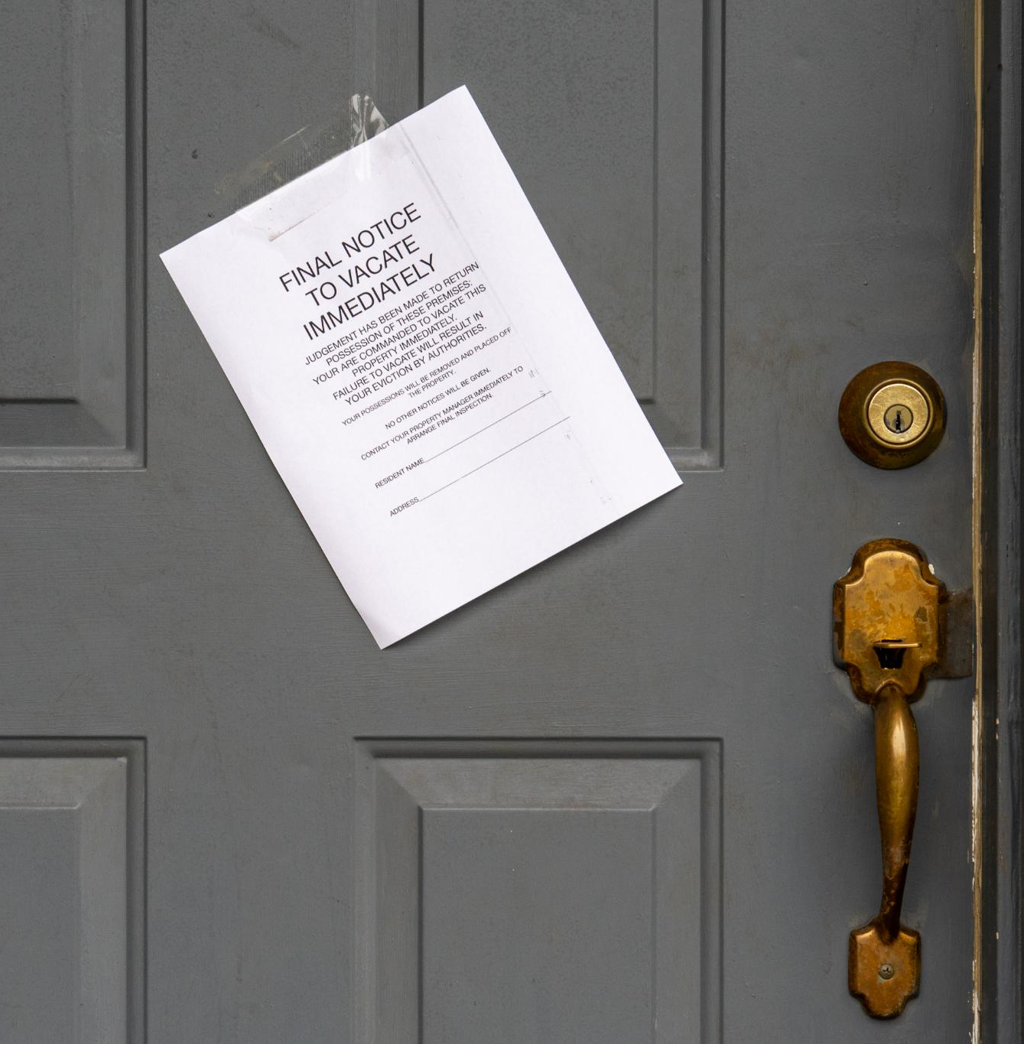
Peace of Mind
Deducting from security deposit
Evictions
Outstanding rent coverage guarantee while legal claims are in place

Slide 10

Add-ons
Coaching Real Estate Investing
Initial Furnishing
“Rent guarantee”
Landscaping
Pest Control | Termite Bond
Gutter Cleaning
Sub-leasing or co-signer clause
New Locks Installed between Leases
BYOP (bring your own provider) or let us manage that for you

Slide 11
Fees
8% of rent collected
Client startup management fee: $200
Tenant Placement: $300
Lease Renewal: $50
Early Contract Termination: $500
Eviction: $300 (varies by county)
Late Rent Occurrence: $50 (per annual year)
Client-late service fee (repair, etc.): 25% of the outstanding balance
Add-ons:
Piece of Mind Package: $50/month **
Utility Provider Set-up: $100
Furnish my rental: $300 + furniture cost
** Rent payment guaranteed regardless if tenant payments are late. Late rent and eviction fees waived.
Notes:
This slide outlines the various fees and add-ons associated with our property management services. Some fees are percentage-based, while others are fixed. We also offer add-ons such as eviction insurance and rent peace of mind for an additional monthly fee. Some fees may be waived if certain add-ons are purchased.
Original Content:
Fees (some waived if purchased add-on)
- Percentage-based Management: 8% of rent collected + fixed-add-ons
- Client startup management fee: $200
- Tenant Placement: $300
- Lease Renewal: $50
- Early Contract Termination: $500
- Eviction: $300 (varies by county)
- Late Rent Occurrence: $50 (per annual year)
- Client-late service fee (repair, etc.): 25% of the outstanding balance
- Add-ons:
- Eviction Insurance: $50/month
- Rent piece of mind (rent paid even if tenant is late on rent): $50/month

Slide 12

History
Specialized in Marietta, Kennesaw, Acworth, and Woodstock areas since 2018
  Managing 6 single family homes with an average of 18 tenants per year
Strong relationships with contractors and handymen
  Quality work at a fair price
Built trust and connections with renters and their network
  Referrals exceed the number of units available to rent
Near 100% satisfaction from both tenants and landlords
Experience in handling claims in Magistrate Court

Slide 13
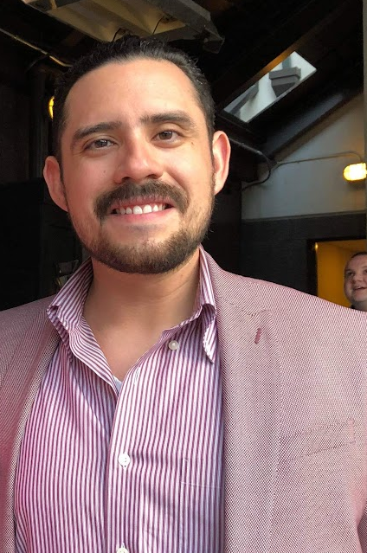
Our Founder | CEO
Adrian Gonzalez's Real Estate Journey
  Purchased 1st home in Marietta, GA in 2018
  Became a homeowner and landlord that same year
Skills and Experience
  Software Engineering background
  Sole Property Manager for all his properties
  Hands-on experience in home repairs
  Builds team of trusted contractors
Growth and Success
  Owned 6 investment properties by 2023
  Uses technology to manage homes while working full-time

Slide 14
Our Process
Client Discussions
1
Marketing
2
Tenant Screening
3
Tenant Onboarding
4
Maintenance Management
5
Tenant Offboarding
6

Slide 15

1. Client Discussions
Learn about each other
Your top priorities and needs
Your Timeline
Other considerations
  Envisioned rent
  Lease duration
  Minimum applicant requirements
  Minimum Security Deposit
Notes:
In our client discussions, we aim to learn about each other, understand your top priorities and needs, and discuss your timeline. We also take into consideration other factors such as envisioned rent, lease duration, minimum applicant requirements, and minimum security deposit.
Original Content:
Client Discussions
Client Discussions
- Learn about each other
- What are your top priority and needs?
- What is your timeline?
- What other considerations do you want us to consider:
- Envisioned rent
- Lease duration
- Minimum applicant requirements (monthly income, credit history, background check red flags)
- Minimum Security Deposit

Slide 16
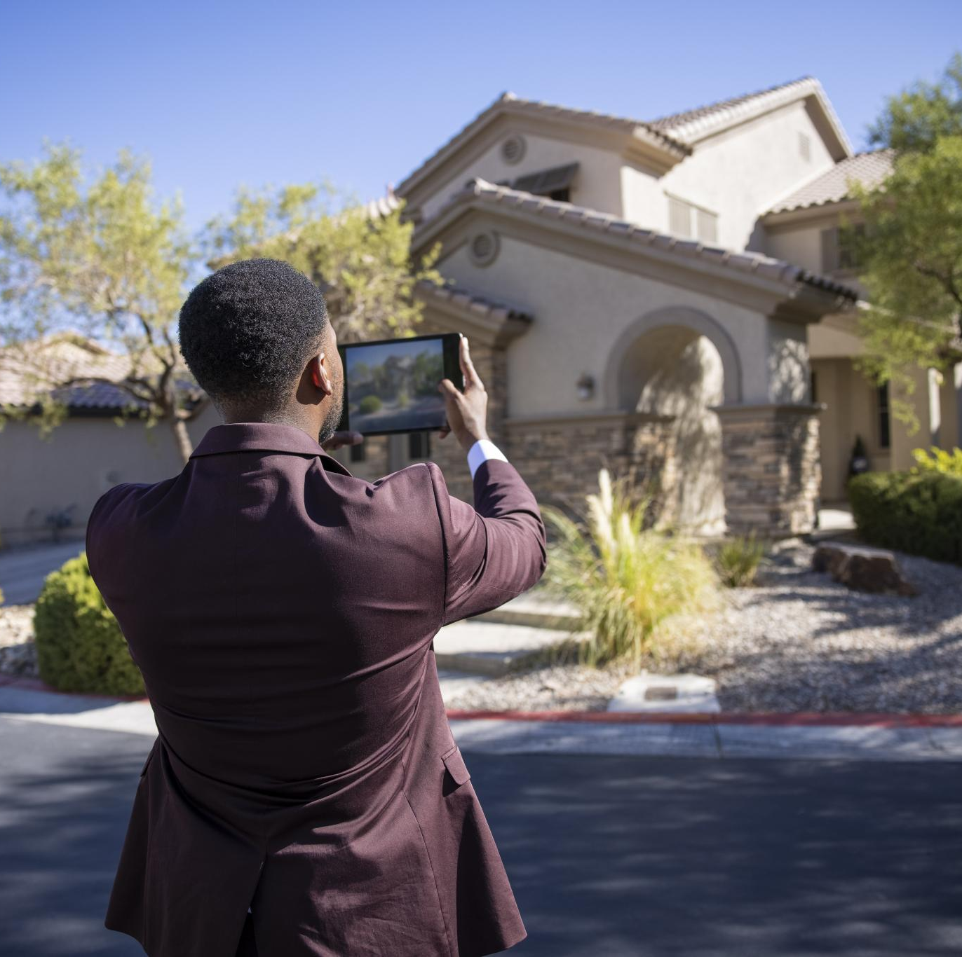
2. Marketing
Professional Profile Creation
  Includes pictures, virtual video tour, and description
Marketing Across Multiple Platforms
  Maximize exposure for your home

Slide 17

3. Tenant Screening
Rigorous screening for credit and background history
  We share all report results with you
  You have the final decision on approval
Applicants educated on application process
  Minimizes misunderstandings

Slide 18

4. Tenant Onboarding
Set you up an account for visibility into deposits, bills, and maintenance requests
Create a Lease Agreement for review
Coordinate signing the Lease Agreement
Collect Security Deposit and 1st Month's Rent
Coordinate with Tenant for move-in
Capture property condition at move-in

Slide 19

5. Maintenance Management
Access to maintenance requests
  See any maintenance requests from tenants
Trusted network of contractors
  Get repair quotes from our trusted contractors
Decision making power
  You decide whether to proceed with repair, explore alternative quotes, or hold off
Transparency
  Access to all repair bills and invoices

Slide 20

6. Tenant Offboarding
Conduct a move-out inspection with the Tenant and flag any damage that wasn’t included in the ‘move-in’ inspection
Deduct from the Tenant’s Security Deposit as applicable
Collect the keys, and if applicable Garage Door Remote from the Tenant
Reset the Garage Door Opener(s)
Change the WiFi password
Change the locks (add-on)
Work with our contractors and cleaners to prepare the unit for future renters

Slide 21

Contact Us
Email: agsquaredpmllc@gmail.com
Facebook
Google
Yelp

